Slide 1
Assignment 2
Target Kaggle - Linear Regression
Dataset Source: https://github.com/ShuaiW/kaggle-regression
Kernel: https://www.kaggle.com/meenaj/bikes/notebook

Slide 2
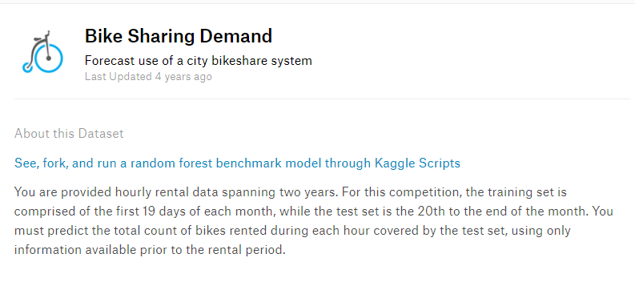
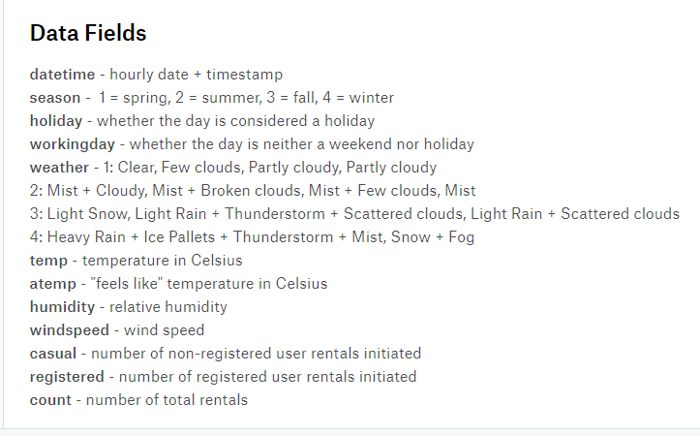
About Dataset

Slide 3
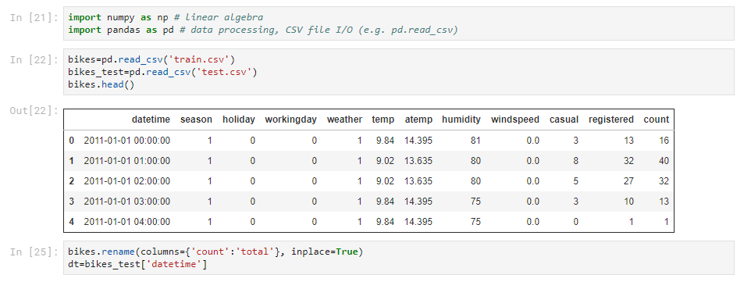
Loading the Dataset

Slide 4
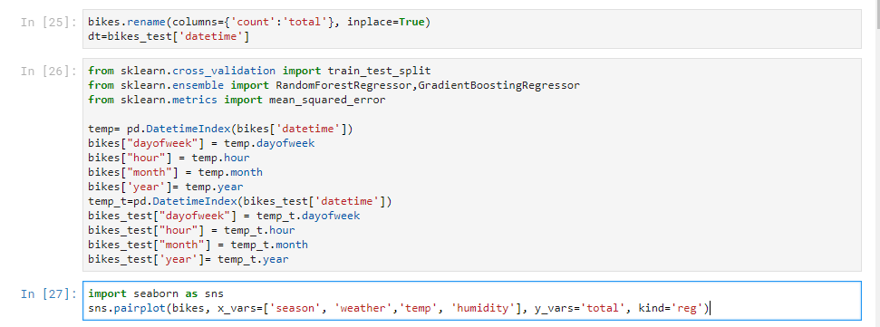
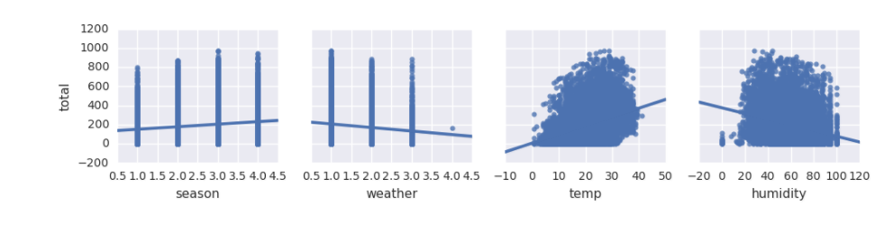
Splitting Daytime feature and Data Exploration

Slide 5
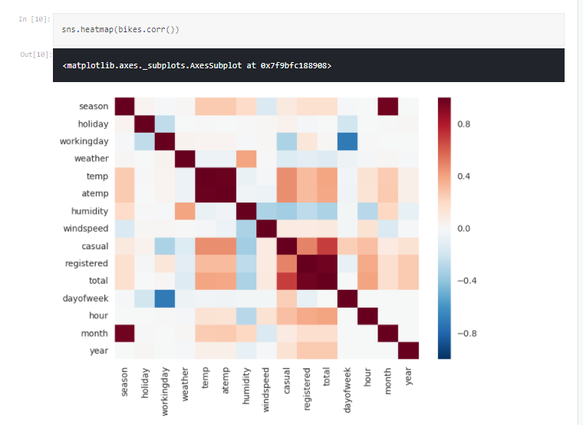
Heat Map

Slide 6
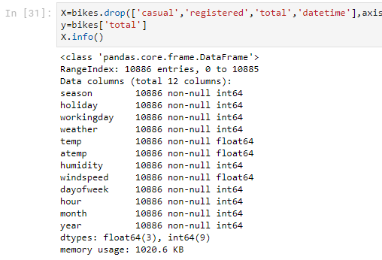
Keeping Best Features

Slide 7
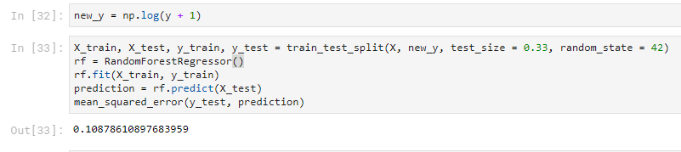
Implementation : Random Forest Decision

Slide 8
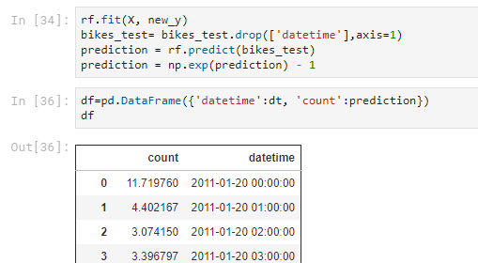
Implementation: Prediction

